Slide 1
DBL Embedded Systems
A sorting machine to sort black and white discs
Group 16
Presenters: Phung D.T. (Dat), Keet M. (Maarten) and Petrescu T. (Tudor)

Slide 2
Subjects
Specification
Machine Design
Use-cases
User constraints
Safety properties
Machine sketch
Design decisions
Priorities
Conclusion

Slide 3
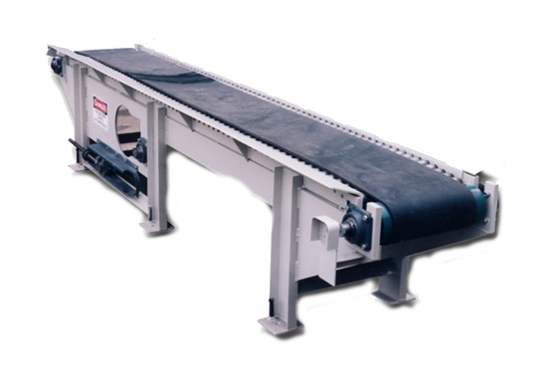
Specification
Conveyer belt requirement
Notes:
We have to make a so called sorting machine. This machine should be able to separate, by colour, small black and white plastic discs. The only real requirement in achieving this is that we need to use at least one conveyor belt. We think the conveyor belt is our biggest disadvantage. It’s rather slow compared to the detectors.

Slide 4
Machine Design
Use-cases
User constraints
Safety properties
Notes:
User constraints
Limit
Necessity: purpose, use-cases, condition
Safety properties
Example

Slide 5
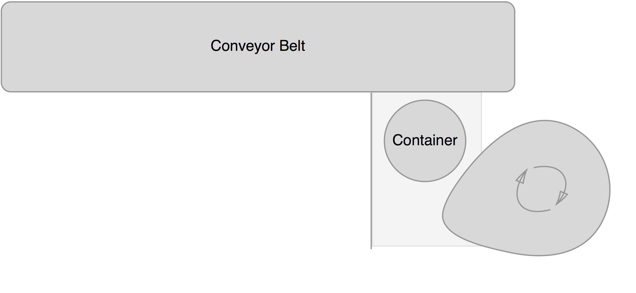
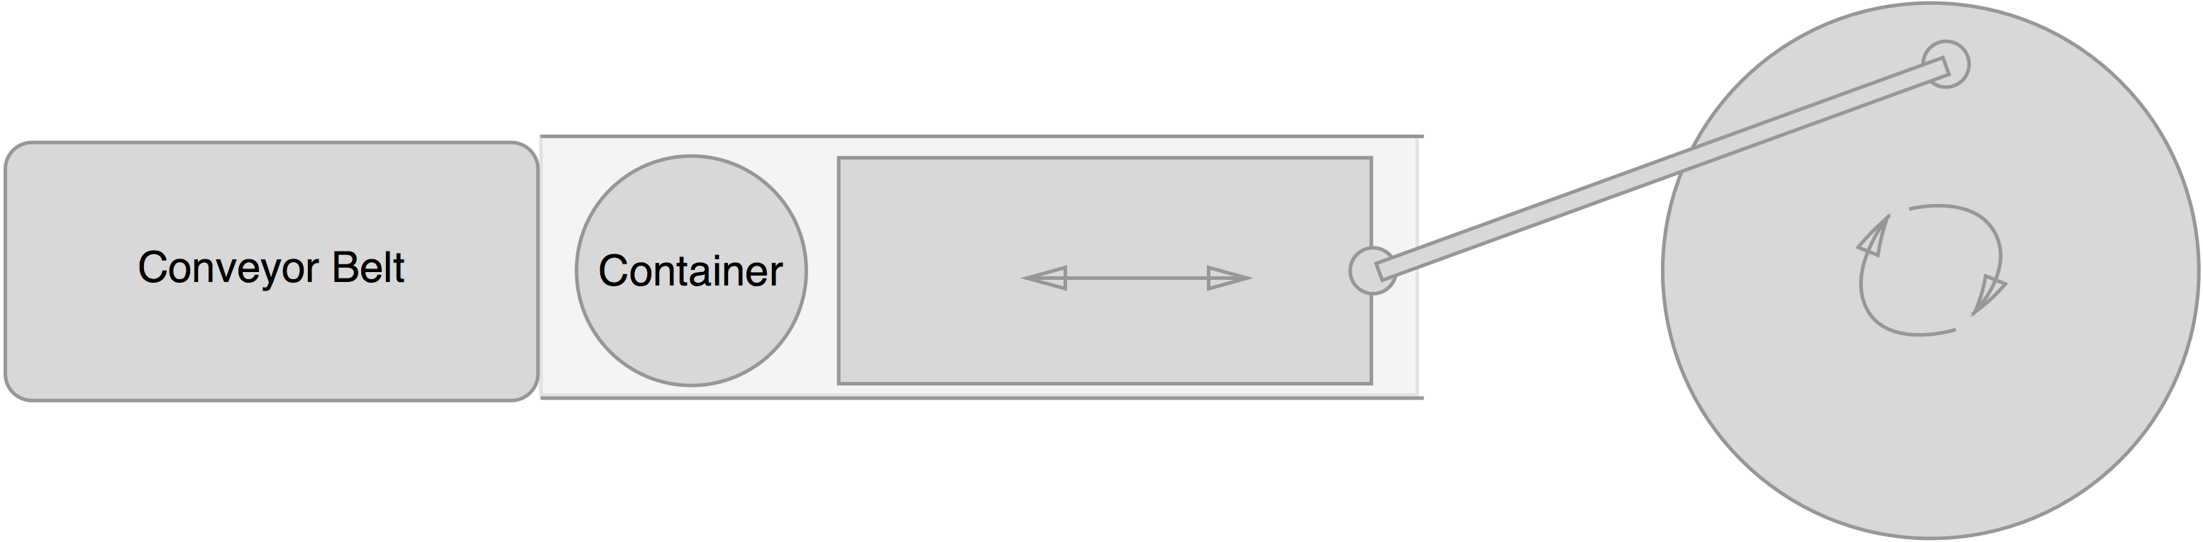
Sketches
Design 1
Design 2
Notes:
Sketch
Now we were talking about the use-cases, user constraints and safety properties, you might have forgotten that we were talking about machine design. So let’s take a design decision we made.
For the use-case “Sort unsorted discs” we need something that disposes discs one by one on the conveyer belt. We came up with two designs and build both of them.
*Show designs*
Both designs make use of the hollow tubes stacked on top of each other. This is convenient because they are reliable in containing the discs and fast because if the bottom disc is removed the next disc, if any, will drop down to the position of the first disc. Robustness is covered too, because there are few parts that may come loose. For user accessibility it’s easy to put new discs to be processed at the top of the tubes.
In the first design there’s a turning wheel with a cam that is able to push the discs one by one onto the belt. A wall to the left of the container makes sure the disk is pushed up and not to the left.
In the second design a moving block would push the discs onto the belt. The block would be driven by a lever attached to a rotating wheel.
Both designs are consistent with the use-case. Tudor will tell you more about our priorities, but both designs were reliable and there was no difference in speed. Both designs didn’t hinder the user, so user accessibility is all right. At the end we chose for the first design, because it was easier to build, had less parts and was a lot more compact.
Then now I will give the word to Tudor, so he can tell you about design decisions.

Slide 6
Design Decisions
Priorities
Correctness
Speed
Robustness
Accessibility
Difficulty building
Amount of parts

Slide 7
Conclusion

